Slide 1

Artificial Intelligence in Education - Factors Associated with AI usage amoung Students
Taskala Lakshmi
<03-09-2025>

Slide 2
INTRODUCTION
My research is about AI in education. I want to understand why the use of generative AI for education differs between students. I am using secondary data from Eurostat rather than collecting my own survey data. I am investigate whether digital skills, educational attainment and the digital environment are associated with the use of AI for education.

Slide 3
PROBLEM STATEMENT
“ This research is to analysis what are all the factors that differs usage of AI amoung students because when i refer the papers in sciencedirect page i found the researches that how AI helps to students or student effected because of AI. So i took the dattasets from eurostat and performing some analysis to know my hypothesis are positive or negitive.

Slide 4
LITERATURE REVIEW
Author(s) | Year | Description | Published in
Hadinejad,Sperling,McGrath | 2025 | Generative AI chatbots in higher education: Student experiences and perceived ethical challengesThe integration of generative artificial intelligence (GAI) chatbots in higher education has introduced both opportunities and challenges for students’ academic practices. | sciencedirect
Deng, Ruiqi | 2025 | Does ChatGPT enhance student learning? A systematic review and meta-analysis of experimental studies.This review examines experimental studies on ChatGPT's impact on student learning to address this gap. | sciencedirect
Chen & Cheung | 2025 | Effect of generative artificial intelligence on university students learning outcomes: A systematic review and meta-analysis.Generative artificial intelligence (Gen-AI) is transforming higher education by enhancing students' learning outcomes. | sciencedirect
Barcaui | 2025 | ChatGPT as a cognitive crutch: Evidence from a randomized controlled trial on knowledge retention | sciencedirect
Heung, Yuk Mui Elly | 2025 | How ChatGPT impacts student engagement from a systematic review and meta-analysis study | sciencedirect
Dong, Liu,Tang, Xiuxiu | 2025 | Examining the effect of artificial intelligence in relation to students’ academic achievement: A meta-analysis | sciencedirect
Han, Xiaoli | 2025 | The impact of GenAI on learning outcomes: A systematic review and meta-analysis of experimental studies | sciencedirect
Kolade, Oluwaseun,Owoseni, Adebowale | 2024 | Is AI changing learning and assessment as we know it? Evidence from a ChatGPT experiment and a conceptual framework | sciencedirect
Azeta, Ambrose,Abayomi-Alli, Adebayo | 2024 | Impact of artificial intelligence adoption on students' academic performance in open and distance learning: A systematic literature review | sciencedirect
Eurostat | 2026 | Provides European data on GenAI use and formal education | sciencedirect

Slide 5
CONCEPTUAL FRAMEWORK
Digital Skills
Usage of AI
Education
Digital environment
Fig 0.0 – Conceptual Framework, Model developed for research

Slide 6
HYPOTHESES
Following assumptions were generated in the form of Hypothesis to authenticate and validate the importance of respective independent variable towards the dependent variable
  H1 Students with higher levels of digital skills have higher levels of generative AI usage for education.
  H2 Students with higher level of education have higher levels of generative AI usage for education.
  H3 Students with stronger level of digital environment have higher levels of generative AI usage for education.

Slide 7
RESEARCH METHODOLOGY
Research problem --> Literature review -->Research question -->Variables -->Hypotheses -->Secondary data collection -->Data preparation -->Descriptive analysis -->Correlation -->Multiple regression -->Hypothesis testing -->Discussion -->Conclusion
The research process follows a systematic quantitative approach to investigate the factors associated with differences in artificial intelligence usage for formal education across European countries. The study begins by identifying the research problem and reviewing existing academic literature concerning artificial intelligence adoption, student learning, digital skills and educational outcomes. The literature review helps identify potential factors that may explain differences in AI usage and provides the theoretical basis for developing the research hypotheses.

Slide 8
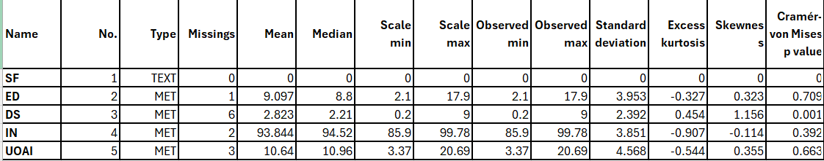
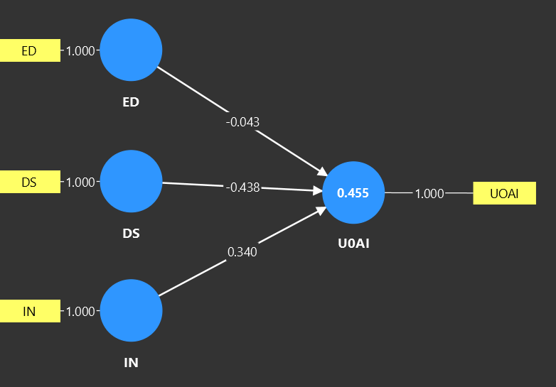
DATA ANALYSIS

Slide 9
HYPOTHESIS RESULTS
Based on analysis from collected data, following are the significance of variables that are Hypothesized for this research.
Item | Description of Hypothesis | Result
H₁ | Students with higher levels of digital skills have higher levels of generative AI usage for education. | Negitive
H₂ | Students with higher level of education have higher levels of generative AI usage for education. | Supportive
H₃ | Students with stronger level of digital environment have higher levels of generative AI usage for education. | Supportive

Slide 10
FINDINGS AND RECOMMENDATION
The path coefficient between ED and UOAI is $-0.043$. Because this value is negative and very close to zero, ED has a negligible to weak inverse effect on UOAI. An increase in ED corresponds to a slight decrease in UOAI.So students with less education cant use ai properly
The path coefficient between DS and UOAI is negative ($-0.438$). This indicates a strong inverse relationship: as DS increases, UOAI decreases significantly.
The path coefficient between IN and UOAI is positive ($+0.340$). This indicates a direct relationship: as IN increases, UOAI increases steadily.

Slide 11
LIMITATIONS AND FUTURE SCOPE
Future research could be investigate the intensity and type of AI usage.
For example, researchers could distinguish between using AI as a tutor, using AI for brainstorming, using AI for feedback and simply copying AI-generated answers.
Another important extension would be to examine knowledge retention.
A student may achieve a higher grade with AI assistance, but that does not necessarily mean that the student retains the knowledge.
The analysis is based on European countries rather than individual students. Therefore, the results should not be interpreted as proving that an individual student with higher digital skills or education will necessarily use more or less AI. The findings represent patterns at the country level.

Slide 12
CONCLUSION
I examined three factors: digital skills, educational attainment and the digital environment.
The results showed different relationships for the three predictors.
Digital skills showed a negative association with AI usage, drop outs in education showed a very weak negative association, while the digital environment showed a positive association.we concluded that education and internet plays a major effect in the students usage of AI.

